Slide 1
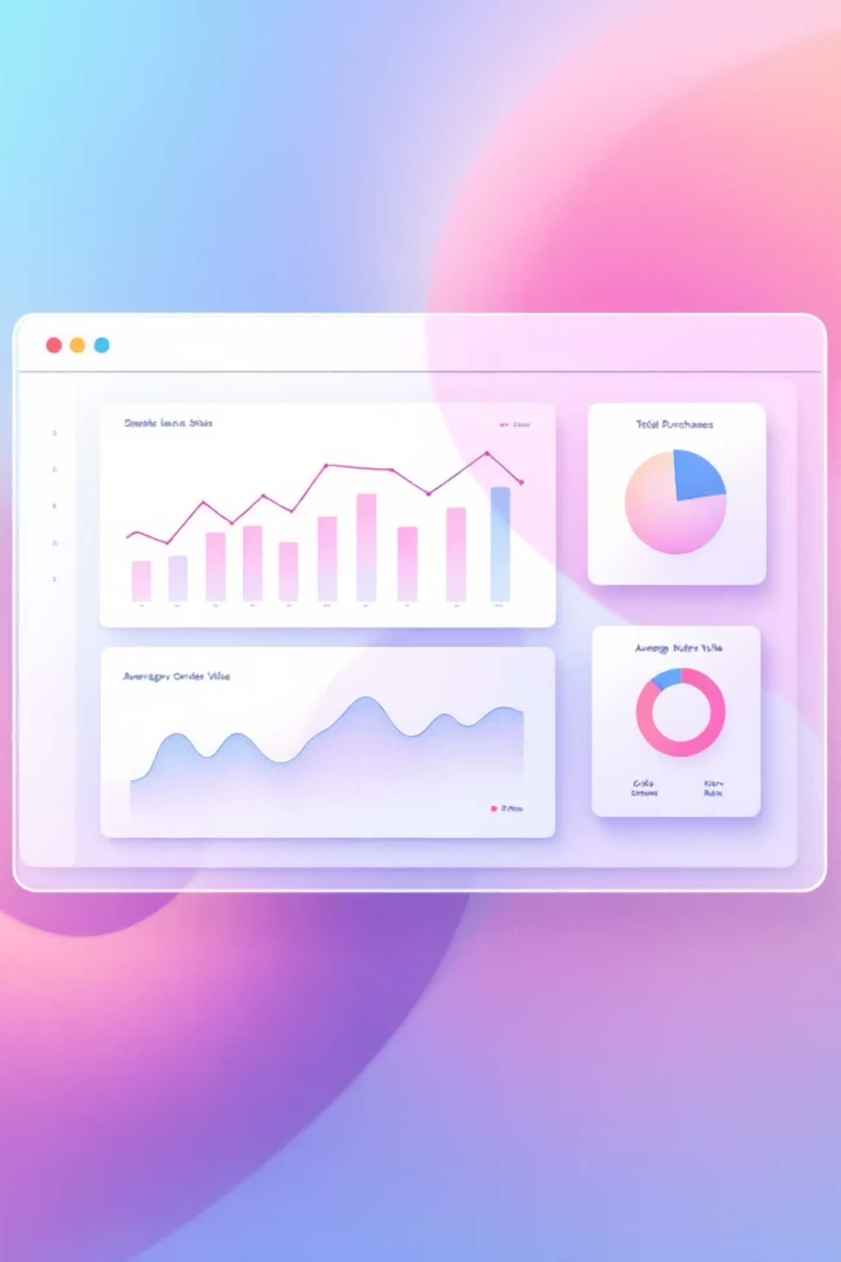
Customer Shopping Behaviour Analysis
3,900 customer purchases analyzed — This project analyzes customer purchases to uncover insights into spending patterns, product preferences, and subscription behavior, guiding strategic business decisions.

Slide 2

Project Overview & Dataset Summary
Project Goal
Dataset at a Glance
Uncover insights into spending patterns, customer segments, product preferences, and subscription behavior to guide strategic business decisions.
Rows: 3,900
Columns: 18 (Demographics, Purchase Details, Shopping Behaviour)
Missing Data: 37 values in Review Rating

Slide 3

Exploratory Data Analysis (Python)
We initiated data preparation and cleaning using Python, ensuring data quality for analysis.
01
02
Data Loading & Exploration
Missing Data Handling
Imported dataset with pandas; checked structure and summary statistics.
Imputed missing Review Rating values using median category ratings.
03
04
Feature Engineering
Database Integration
Created age_group and purchase_frequency_days columns.
Loaded cleaned data into PostgreSQL for SQL analysis.

Slide 4

Key SQL Analysis Findings
Structured analysis in PostgreSQL revealed critical business insights.
Revenue by Gender
Top 5 Products by Rating
Male: $157,890, Female: $75,191
Gloves (3.86), Sandals (3.84), Boots (3.82), Hat (3.8), Skirt (3.78)
Shipping Type Comparison
Subscribers vs. Non-Subscribers
Express: $60.48 avg. purchase; Standard: $58.46 avg. purchase.
Subscribers: 1,053 customers, $62,645 total revenue.

Slide 5
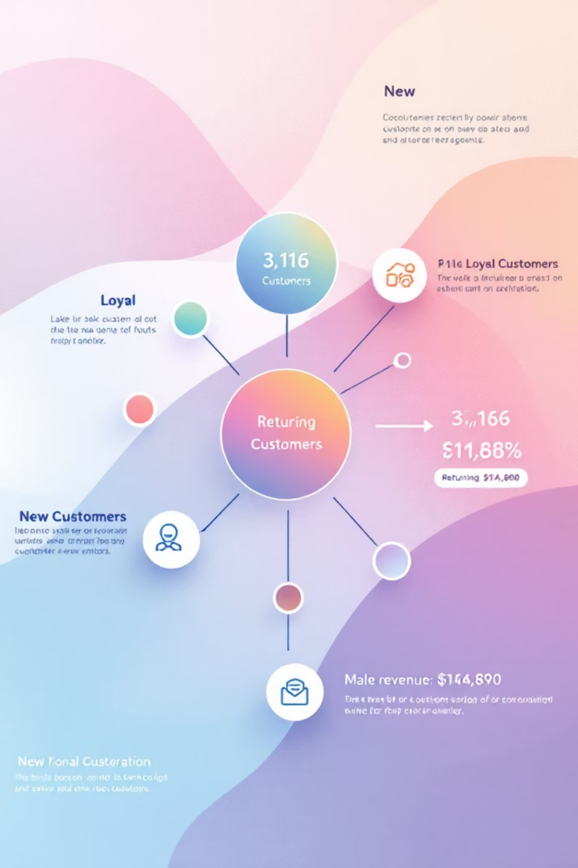
Customer Segmentation & Product Insights
Customer Segments
Discount-Dependent Products
3,116 Loyal Customers
Returning: 701 customers
New: 83 customers
Hat: 50% discounted purchases
Sneakers: 49.66% discounted purchases
Coat: 49.07% discounted purchases

Slide 6




Top Products Per Category
Identifying the most purchased items within each product category.
Accessories
Clothing
Footwear
Outerwear
Jewelry, Sunglasses, Belt
Blouse, Pants, Shirt
Sandals, Shoes, Sneakers
Jacket, Coat

Slide 7
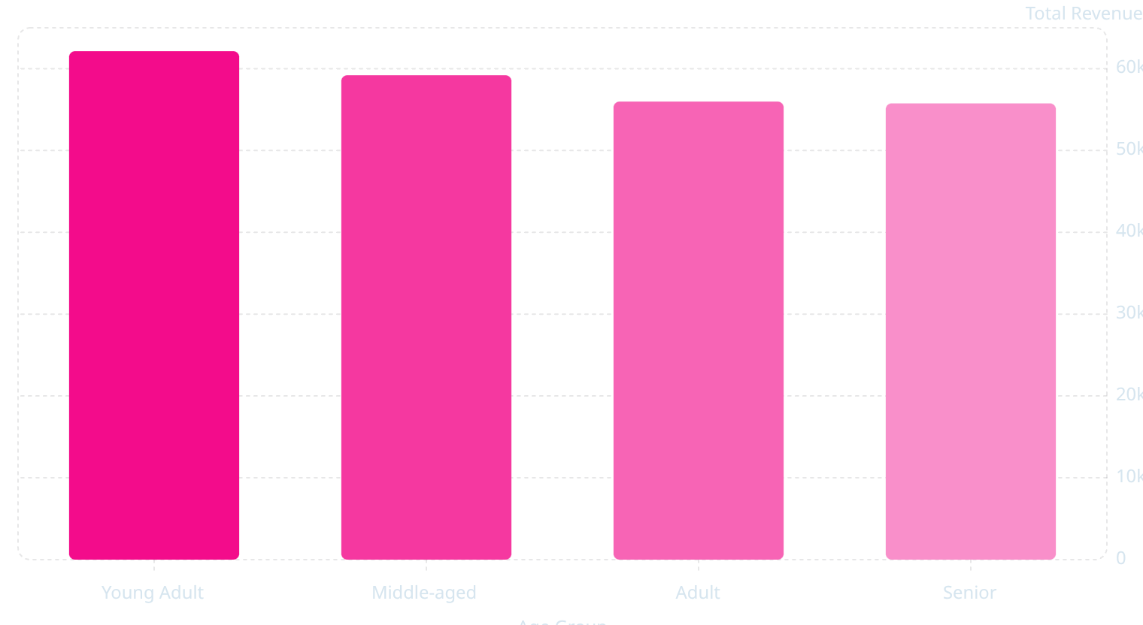
Revenue by Age Group
Young Adults contribute the highest revenue, followed closely by Middle-aged customers, indicating strong purchasing power across these demographics.

Slide 8
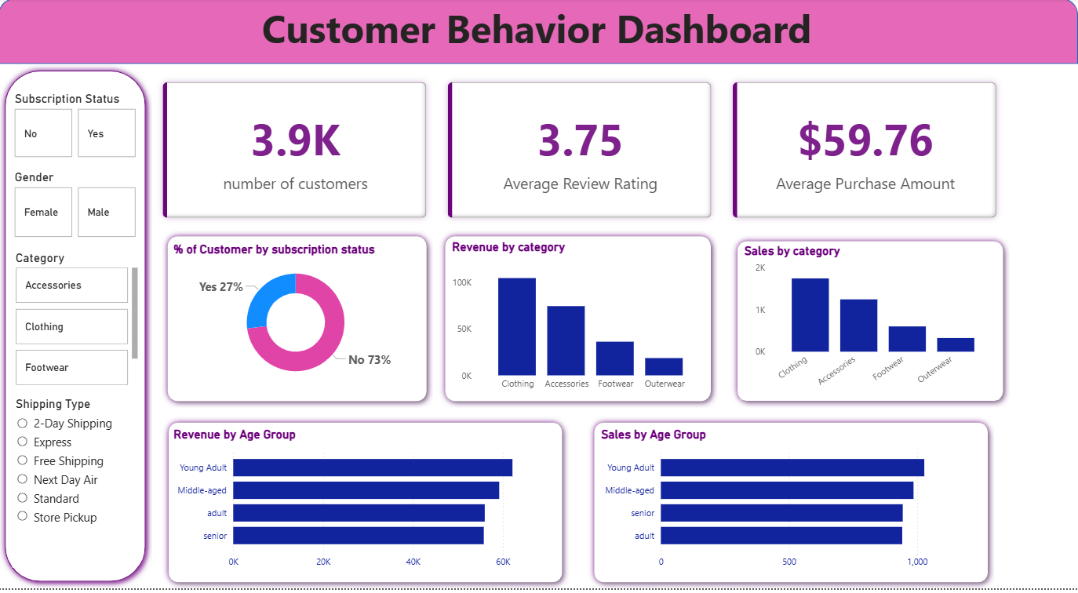
Interactive Power BI Dashboard
An interactive Power BI dashboard provides visual insights into subscription status, revenue by category, and sales by age group.

Slide 9
Key Business Recommendations
Boost Subscriptions
Customer Loyalty
Promote exclusive benefits to increase subscriber base.
Implement programs to reward repeat buyers and foster loyalty.
Review Discount Policy
Targeted Marketing
Optimize discount strategies to balance sales and profit margins.
Focus campaigns on high-revenue age groups and express shipping users.

